Slide 1
Lithography using self assembly: block co-polymer self assembly, porous anodized aluminum oxide and nano-sphere lithography
Di-block copolymer self assembly overview.
Guided (directed, aligned) self assembly.
Block copolymer lithography.
Anodized aluminum oxide (AAO) overview.
Nanofabricating using AAO template.
Nanoparticle self assembly (nanosphere lithography) overview.
Nanofabrication using nanosphere lithography.
Guided nanoparticle self assembly.
Applications of nanosphere lithography
ECE 730: Fabrication in the nanoscale: principles, technology and applications
Instructor: Bo Cui, ECE, University of Waterloo; http://ece.uwaterloo.ca/~bcui/
Textbook: Nanofabrication: principles, capabilities and limits, by Zheng Cui

Slide 2
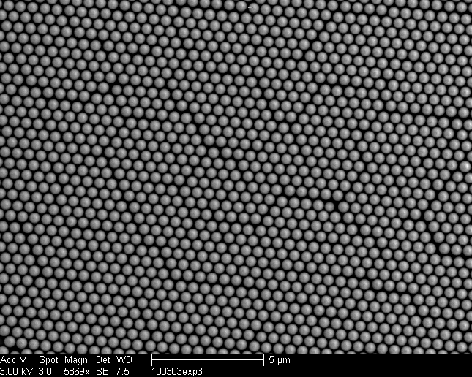
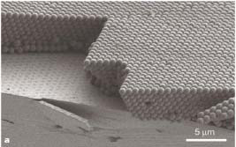
Self assembly of colloidal particles
2D self assembly (mono-layer) 3D self assembly
Typical particle size 100-1000nm, larger is easier to assembly into more regular arrays

Slide 3
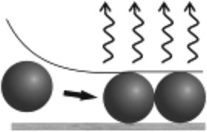
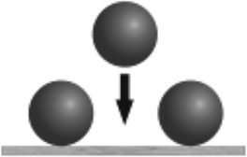
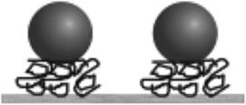
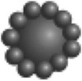
Common techniques for colloidal particles self assembly
Sedimentation from bulk liquid, 3D, low cost
Evaporation of solvent, 2D or 3D, most popular
Adsorption, 2D or 3D (layer by layer)
External force field
(electric, magnetic), 1D 2D or 3D, not scalable to large area
Bio-specific, 1D 2D or 3D, high cost
Templated on surfaces, 1D 2D or 3D
Templated on droplets
“Materials Fabricated by Micro- and Nanoparticle
Assembly – The Challenging Path from Science to
Engineering”, Advanced Materials, 2009

Slide 4
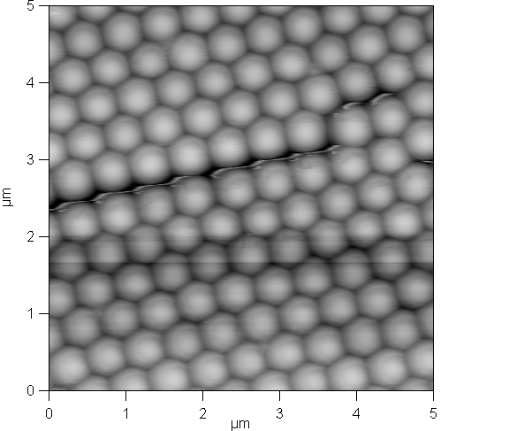
2D and 3D assembly by solvent evaporation
Capillary force (surface tension) due to meniscus formation, most important.
Convective flow due to water evaporation.
Forces that hold the particle together: Van der Walls force, hydrogen bond, ionic interaction force...
Water convective flow
Particle convective flow
Water evaporation
Surface tension

Slide 5
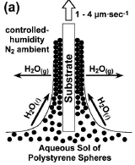
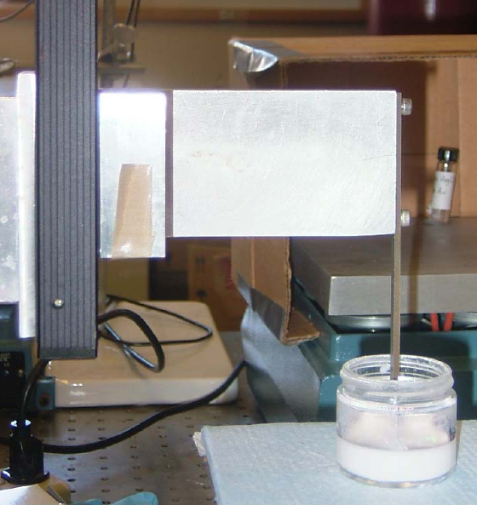
Slow vertical withdrawal method
Increased evaporation
Evaporation
Motor
Solution of nano-sphere
Continuous convective assembly using a stepper motor.
Slide is withdrawn out of the solution at a particular rate (slow: ∼60μm/min; fast: 180μm/min)
3D sphere assembly
Appl. Phys. Lett., Vol. 77, No. 17, 23 October 2000

Slide 6
Slow vertical withdrawal method
Generally, the film thickness depends on:
Lifting speed,
Solution concentration,
Temperature,
Air humidity,
Sphere size.

Slide 7
Horizontal movement method
W, Width of cuvette
R, Humidity ratio
T, temperature
S, Shape of meniscus
C, Concentration ratio of liquid
H, height of meniscus
Substrate, glass
Speed of horizontal movement

Slide 8
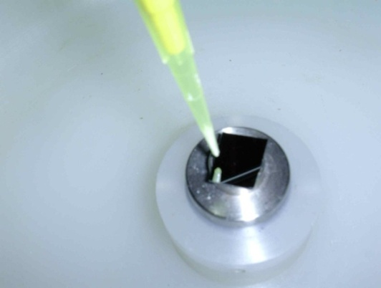
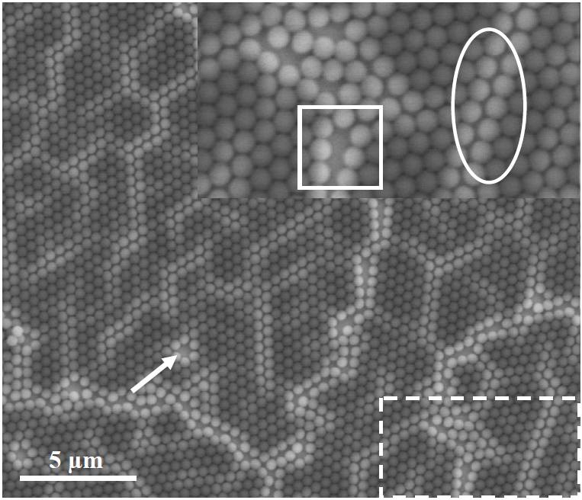
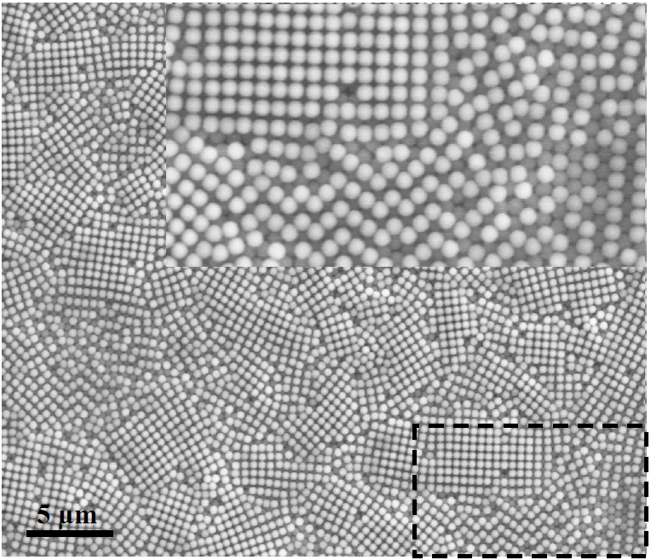
Spin-coating method: mono- and bi-layer
Spin coating or drop coating using polystyrene or silica sphere is the most popular form of nanosphere lithography.
Spinner is very available, relatively easy to get mono-layer, as needed for nanofabrication (i.e. pattern transfer to substrate).
Pipette
Spinner
Polystyrene (PS) sphere 500nm
Mono-layer
Bi-layer

Slide 9
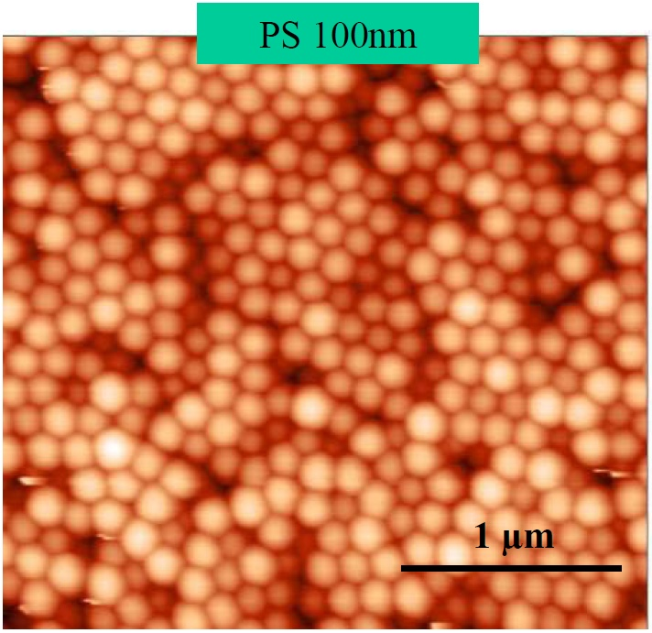
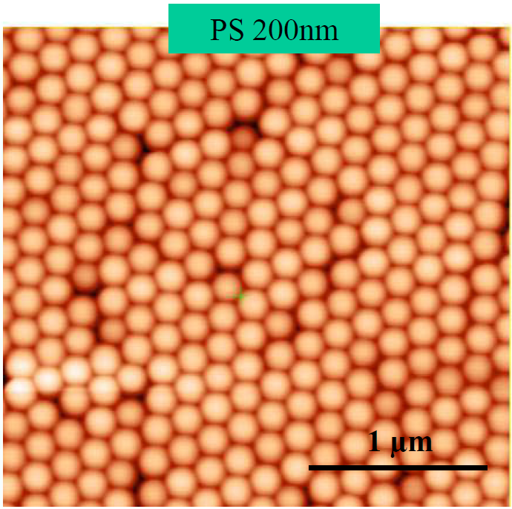
Spin-coating method: effect of sphere size
PS 100nm results in disordered multilayer
PS 200nm results in ordered packing of nanoparticles
Generally, larger is easier to assembly

Slide 10
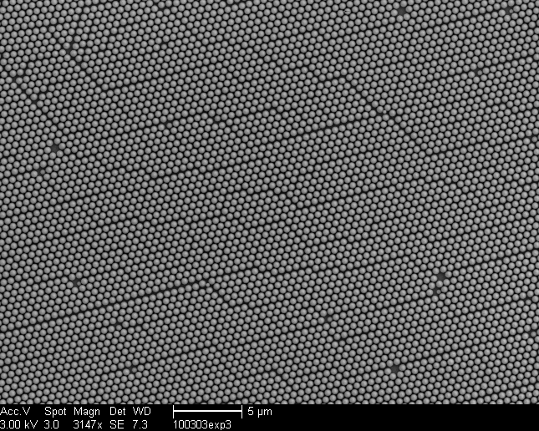
Spin coating procedure
N(100) type Si substrates were utilized
Solution of 5μL of polystyrene nano-spheres and 25μL of ethanol
Spin coated on the substrate at 1500 rpm for 1 minute
Yielded most consistent results

Slide 11
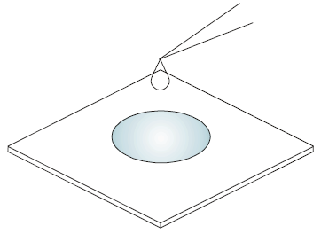
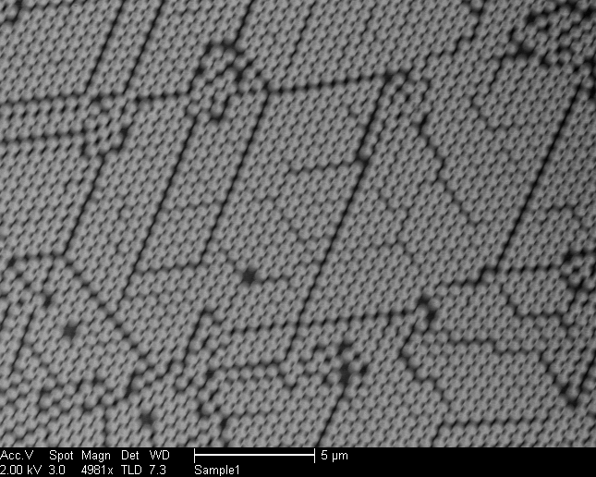
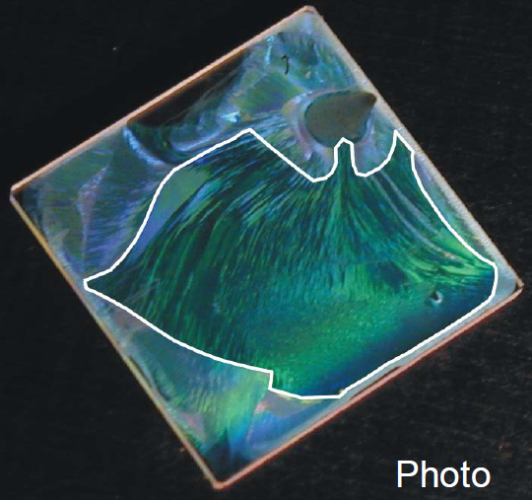
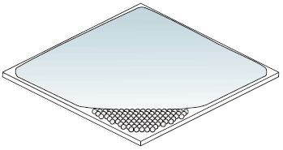
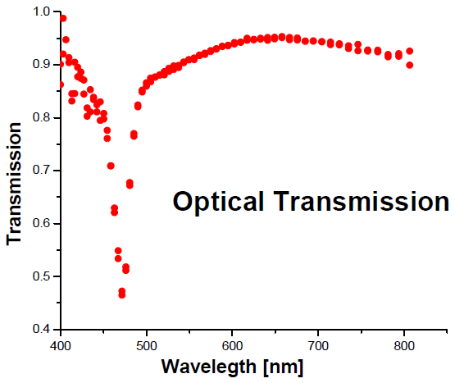
Drop coating procedure
Solution of 3μL of polystyrene nano-spheres and 15μL of ethanol was pipetted onto the substrate
Spread around by rotating the wrist
Sample was allowed to dry naturally or in oven
Spheres self-assemble at meniscus edge
Many gap/line defects

Slide 12
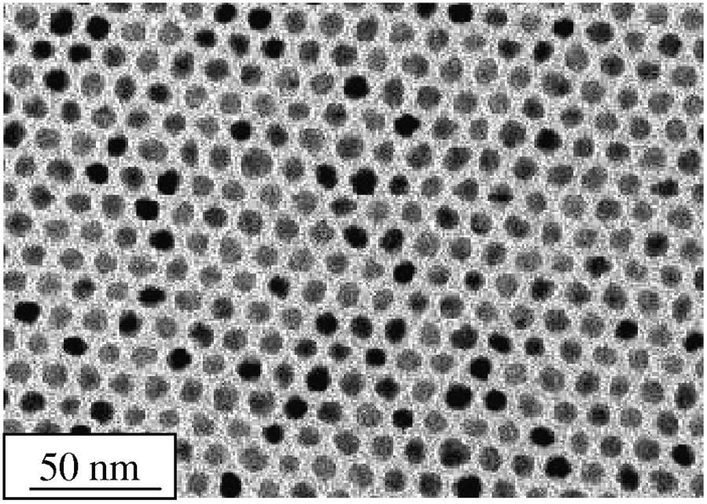
Fe-Pt nanoparticles self assembly by drop coating
Transmission electron microscope image of self-assembled layer of 6 nm diameter Fe–Pt nanoparticles
Here particle size is only 6nm, similar result for 4nm particle. (Typical nanosphere lithography uses particle >100nm for better ordering)
Fe-Pt is a good magnetic material, and this technique has been considered promising for bit-patterned magnetic recording (one particle, one bit; 17 Tbit/in²)
Though today guided di-block copolymer self assembly draws a lot more attention.
IBM, “Lithography and self-assembly for nanometer scale magnetism”, Microelectronic Engineering, 61–62, 569–575 (2002)

Slide 13
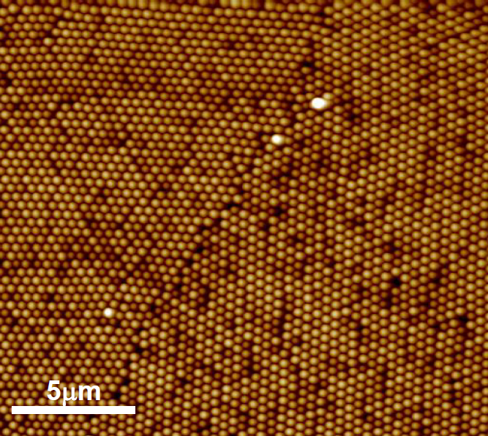
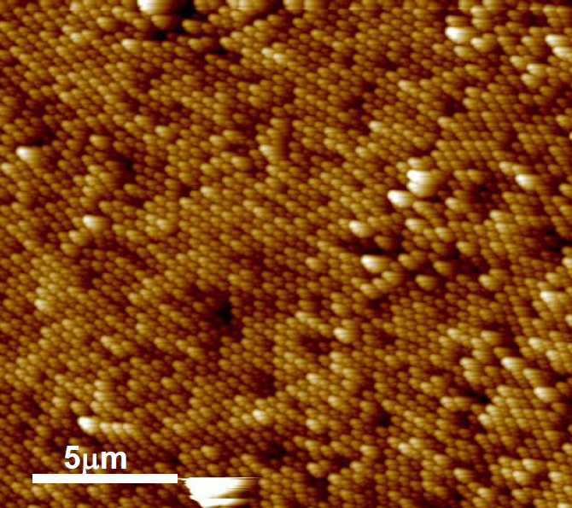
Substrate cleaning is important
Surface needs to be very clean, with low (ideally <20º) contact angle for the sphere solution.
900nm spheres
Piranha/RCA
Piranha: concentrated sulfuric acid and 30% hydrogen peroxide, usually 3:1
RCA #1: H₂O/NH₄OH/H₂O₂=5:1:1, 80ºC
Chromic/sulfuric acid bath
Chromium trioxide in concentrated sulfuric acid
http://en.wikipedia.org/wiki/Piranha_solution
http://en.wikipedia.org/wiki/RCA_clean

Slide 14
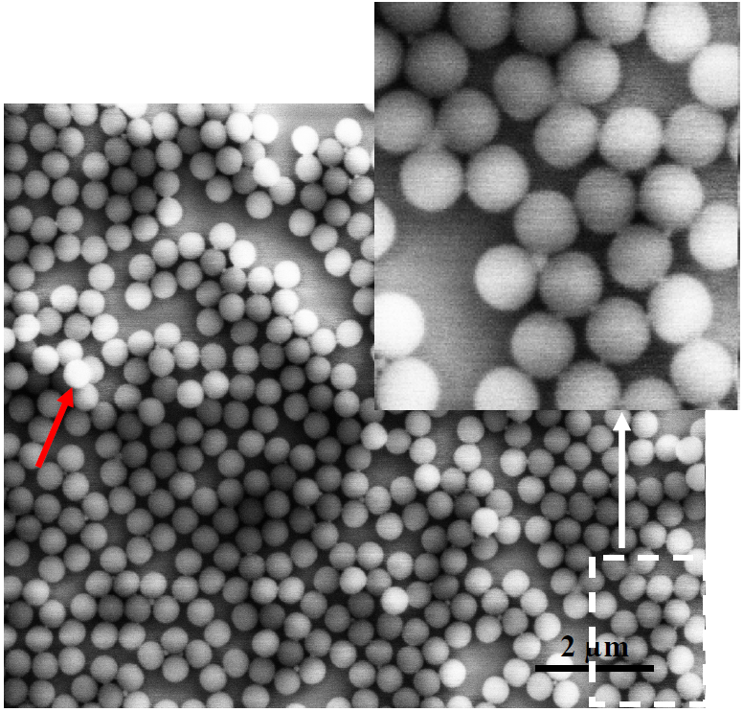
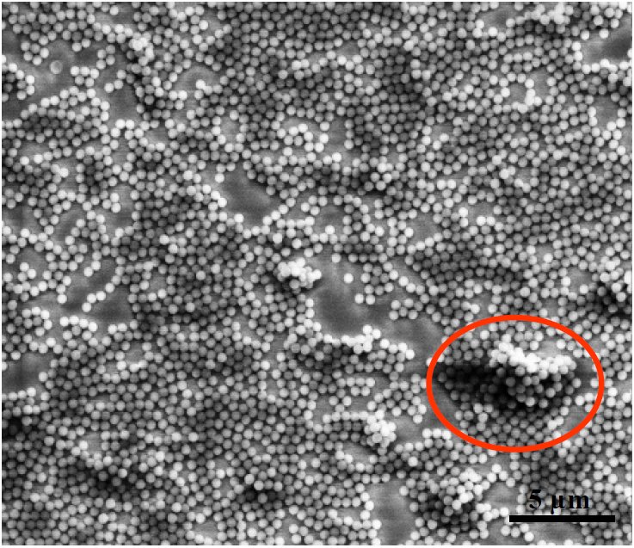
When sphere adhesion to substrate is too strong
Ionic assembly → inhomogeneous layers, high adhesion to the substrate
Low sphere adhesion is needed for periodic structures.
Adhesion force needs to be << capillary force due to surface tension

Slide 15
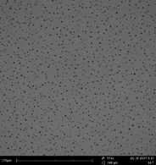
Surfactant helps to spread out the spheres
Nanosphere assembly by spin coating, using surfactant TritonX-100.
Sphere spreads across the entire surface, making concentration “looks” too low.
Need increase sphere concentration

Slide 16
Multi-layer sphere with different lattice constants
After annealing, a second opaline film can be crystallized on top of these films and so on, in order to form multilayer films composed of functional opal layers of spheres with different lattice constants.

Slide 17
Lithography using self assembly: block co-polymer self assembly, porous anodized aluminum oxide and nano-sphere lithography
Di-block copolymer self assembly overview.
Guided (directed, aligned) self assembly.
Block copolymer lithography.
Anodized aluminum oxide (AAO) overview.
Nanofabricating using AAO template.
Nanoparticle self assembly (nanosphere lithography) overview.
Nanofabrication using nanosphere lithography.
Guided nanoparticle self assembly.
Applications of nanosphere lithography

Slide 18
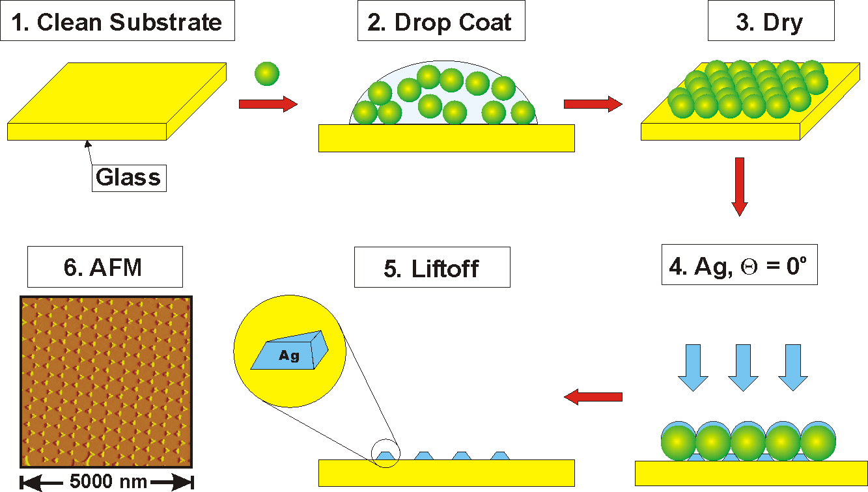
Nanosphere lithography
J. C. Hulteen, et al., J. Vac. Sci. Technol. A, 13, 1553 (1995).

Slide 19
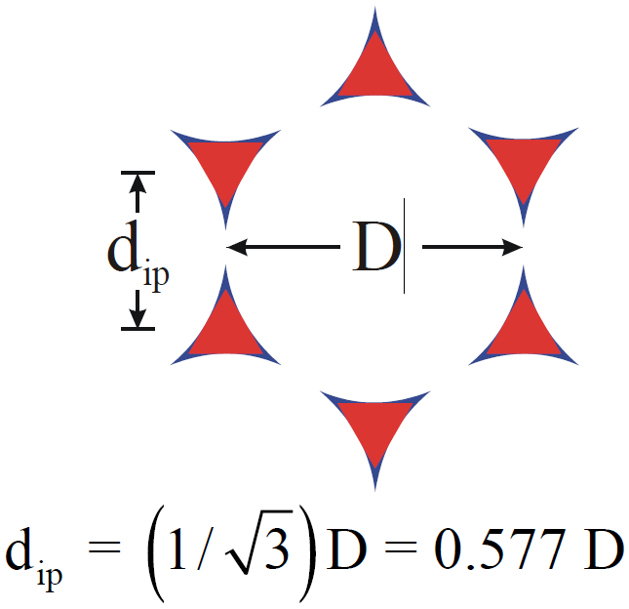
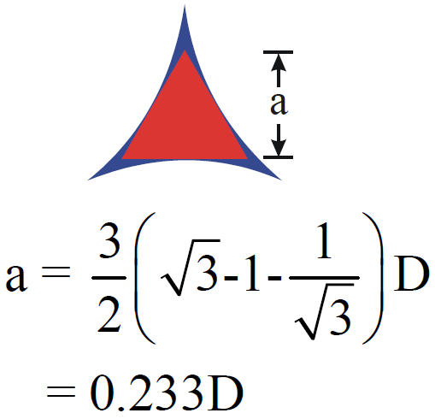
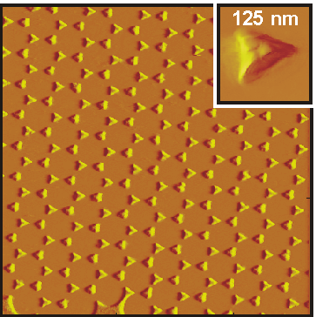
Size and spacing control
D = 542 nm
a = 126 nm; d_{ip} = 313 nm

Slide 20
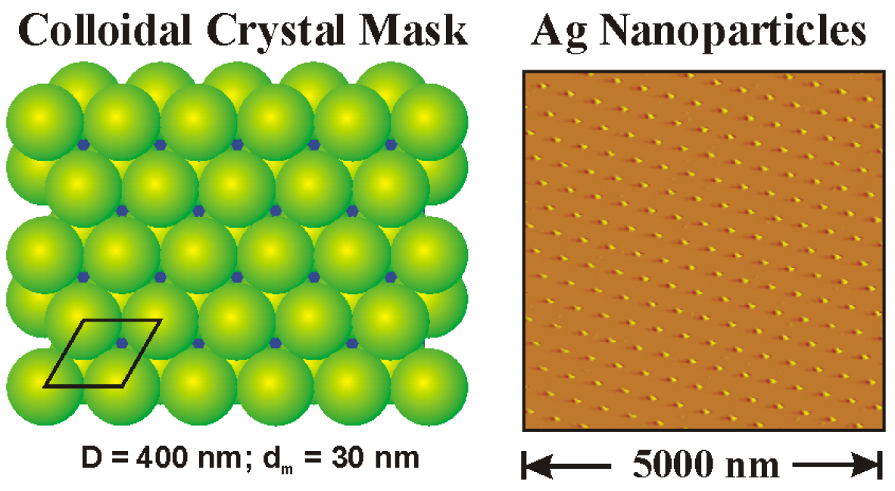
Nanosphere lithography: double layer mask

Slide 21
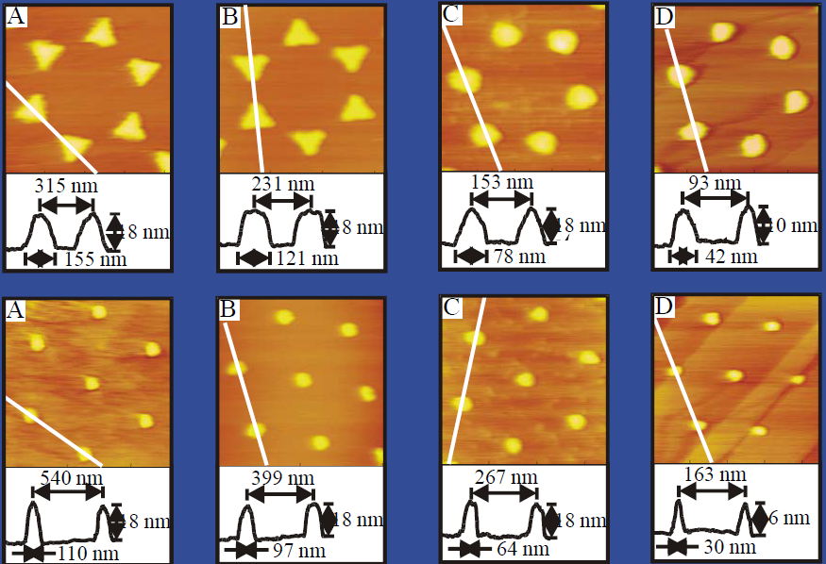
Size-tunable Ag nanoparticle arrays
Single layer
Double layer
D= 542 nm 401 nm 266 nm 165 nm
J. C. Hulteen, D. A. Treichel, M. T. Smith, M. L. Duval, T. R. Jensen, R. P. Van Duyne, J. Phys. Chem. B, 3854-3863 (1999).

Slide 22
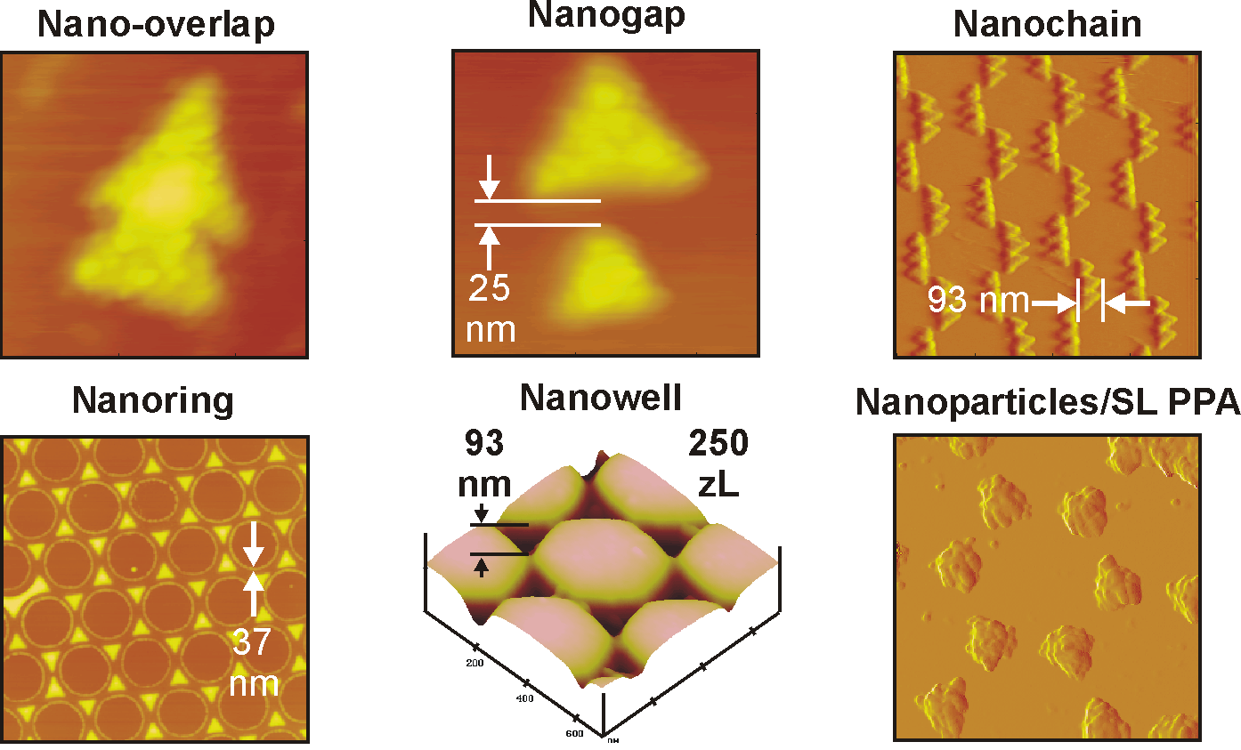
New structural motifs for nanosphere lithography

Slide 23
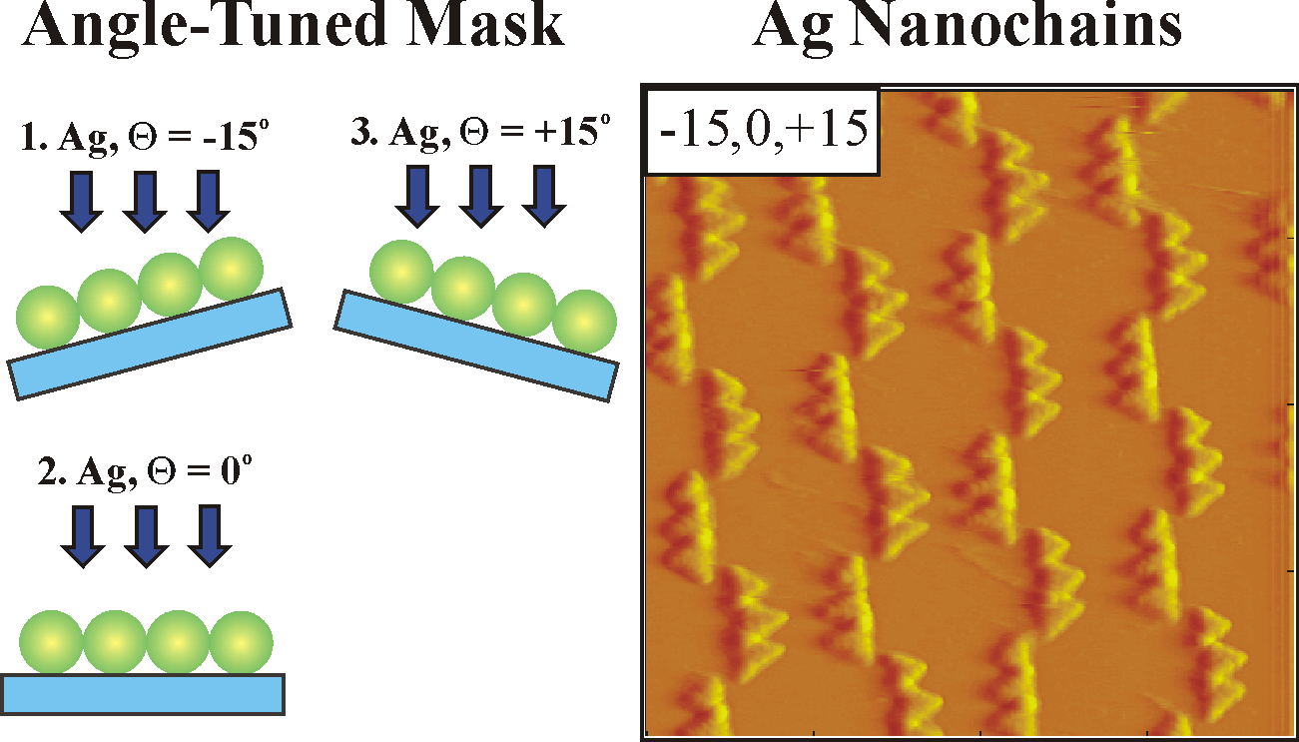
Angle resolved nanosphere lithography
C. L. Haynes, R. P. Van Duyne, J. Phys. Chem. B, 105, 5599 (2001).

Slide 24
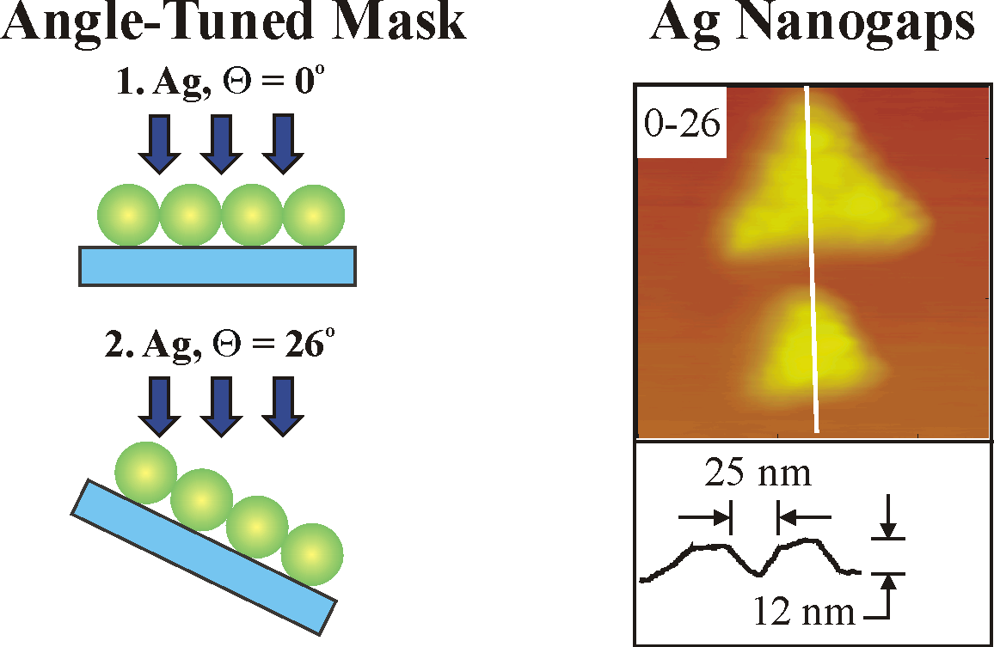
Angle resolved nanosphere lithography
1 nm gap spacing is achievable experimentally
C. L. Haynes, R. P. Van Duyne, J. Phys. Chem. B, 105, 5599 (2001).

Slide 25
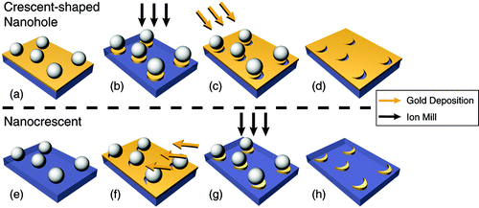
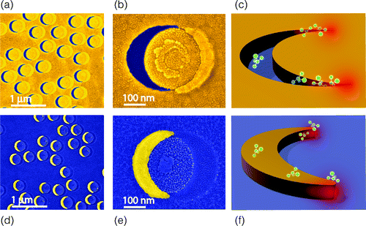
Nano-crescent by nanosphere lithography
(a-d) for crescent-shaped nano-holes;
(e−h) for nano-crescents.
SEM images (false color) of (a, d) random arrayed and (b, e) single structures and (c, f) a conceptual illustration of molecular detection for (a−c) crescent-shaped nano-holes and (d−f) nano-crescents. The crescent-shaped nano-hole achieves sharper tips with <10 nm radius of curvature
Luke P. Lee, “Optical Properties of the Crescent-Shaped Nanohole Antenna”, Nano Lett. 2009

Slide 26
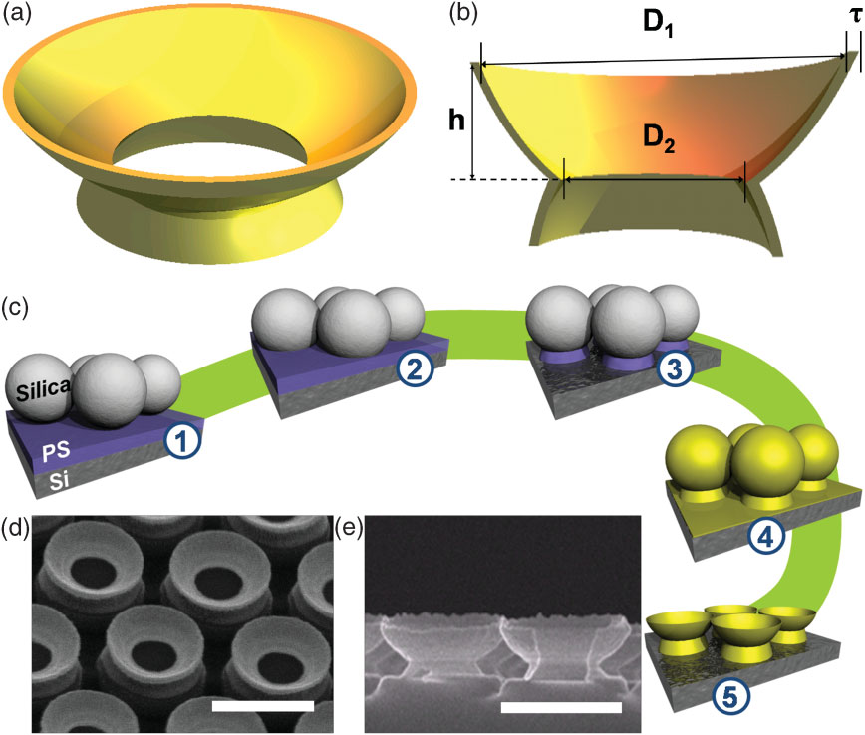
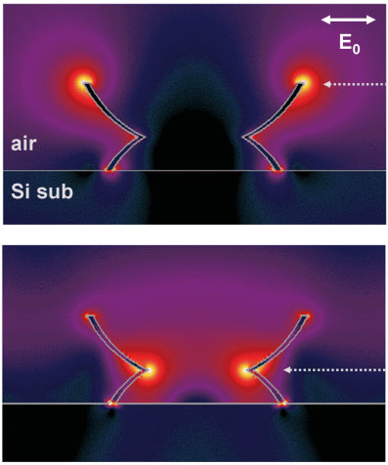
Nano-grails by nanosphere lithography
Gold nanograil with three sharp ring edges.
The gold nanograils are characterized by the overall thickness of the gold layer (τ), the diameter of the rings (D₁ and D₂), and the vertical separation between the rings (h).
Schematic representation of the gold nanograil fabrication:
Silica colloidal particles (diameter 610nm) are spin-coated onto the 150nm thick polystyrene film,
The particles are embedded in the polystyrene film.
A two-step reactive ion etching process with CF₄ and O₂ is performed to reduce the particle size and to remove the underlying polystyrene layer.
A thin layer of gold (40nm) is sputtered onto the whole structure.
Ar ion milling is performed to partly remove the deposited gold. The remaining silica particles are dissolved using a dilute HF solution (5 vol %).
SEM images with tilted view-angles of 30º.
SEM images with 90º tilt angle (side view). Scale bars are 500nm.
Optical properties of the gold nanograil array with D₁=471nm, D₂=225nm, h=118nm, and τ=15nm. Lattice constant of the hexagonal array is 610nm.
Calculated electric field intensity (E²) distributions of the two pronounced plasmon resonances (λ=1651nm and 728nm)
“Gold ‘‘Nanograils’’ with Tunable Dipolar Multiple
Plasmon Resonances”, Advanced Materials, 2009

Slide 27
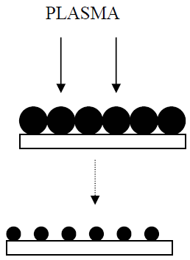
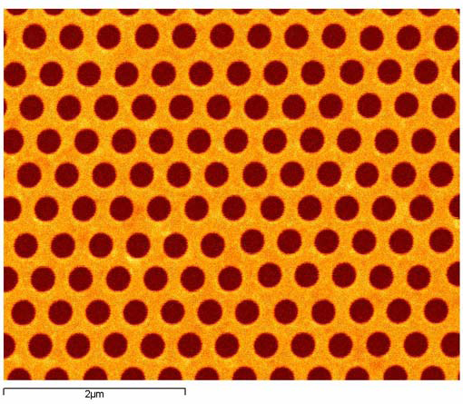
Sphere shrinkage for nano-hole array fabrication
Evaporate metal and remove nano-spheres, leaving hexagonal array of holes in a metal film.
Etch nanosphere array in an oxygen plasma

Slide 28
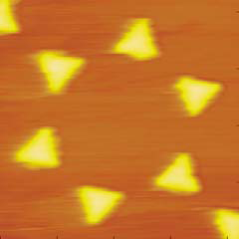
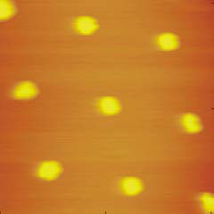
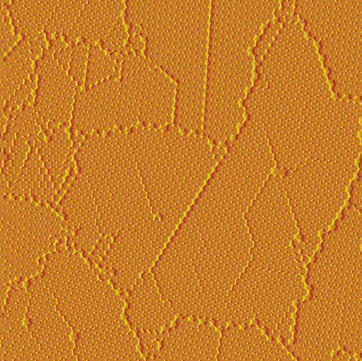
Advantage/disadvantages of nanosphere lithography
Advantage:
Fast parallel patterning
Simple, inexpensive: < $1/sample
A lot easier and cheaper than block copolymer self assembly and AAO process (AAO - anodized aluminum oxide).
Materials and substrate general
Minimum feature size is ∼20nm
Precise control of nanoparticle size and nano-gaps
Disadvantage:
No arbitrary patterns
No independent control of in-plane size and spacing
0.1 – 1% defects from nanosphere poly-dispersity, line defects, point Defects
Polycrystalline domains

Slide 29
Lithography using self assembly: block co-polymer self assembly, porous anodized aluminum oxide and nano-sphere lithography
Di-block copolymer self assembly overview.
Guided (directed, aligned) self assembly.
Block copolymer lithography.
Anodized aluminum oxide (AAO) overview.
Nanofabricating using AAO template.
Nanoparticle self assembly (nanosphere lithography) overview.
Nanofabrication using nanosphere lithography.
Guided nanoparticle self assembly.
Applications of nanosphere lithography

Slide 30
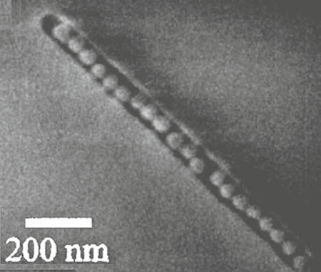
Methods for guided nanosphere self assembly
Self assembly only generates lattice-like periodical array, which is useful for data storage, photonic crystals…
For even broader applications, it needs to be guided to form 1D structure, arbitrary configurations on pre-patterned surface…
External force field
(electric, magnetic), 1D 2D or 3D, not scalable to large area
Bio-specific, 1D 2D or 3D, high cost (antigen-antibody or DNA-cDNA binding)
Templated on surfaces, 1D 2D or 3D
Templated on droplets
Guided self-assembly of nanoparticles by surface topography

Slide 31
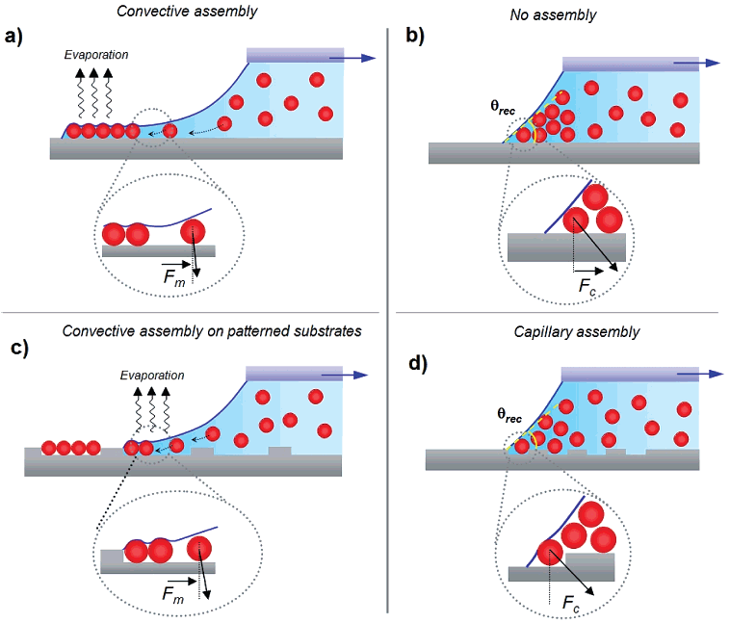
Guided nano-sphere assembly on patterned substrate
Convective assembly is obtained on wetting substrates for contact angle values below 20°. The assembly mechanism is driven by the convective flow of solvent induced by evaporation at the contact line of the droplet:
(a) on flat surfaces, continuous 2D layers of packed particles are formed.
(c) on patterned surfaces, 2D discontinuous arrangements are formed.
When contact angle > 20° :
(b) on flat surfaces, no sphere deposition occurs.
(d) on patterned surface, the combined effect of geometrical confinement and capillary forces created when the meniscus is pinned on the structures of a patterned substrate can be used to deposit only one or a few particles.
Malaquin et al. “Controlled particle placement through convective and capillary assembly”, Langmuir, 23, 11513-11521 (2007).

Slide 32
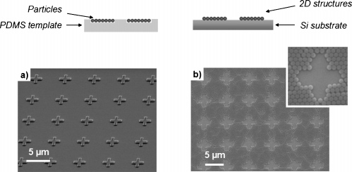
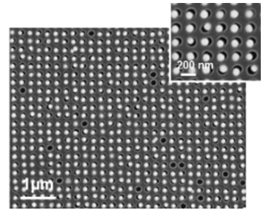
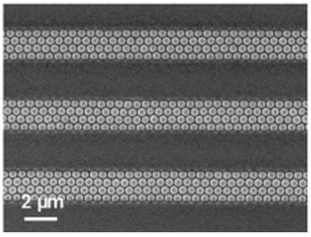
Guided nano-sphere assembly on patterned substrate
2D arrangement of 500nm PS particles created by convective assembly on a 200nm-deep patterned PDMS substrate
After transferred by printing a gold-coated silicon wafer heated to 120°C. (glass transition temperature 105ºC, lower than120°C)
Sparse arrays of 100nm gold nanoparticles assembled into 80nm-deep and 120nm-wide patterns in PDMS.
PS particles (500nm) assembled into 500nm-deep and 1.7μm-wide micro-channels in PDMS.

Slide 33
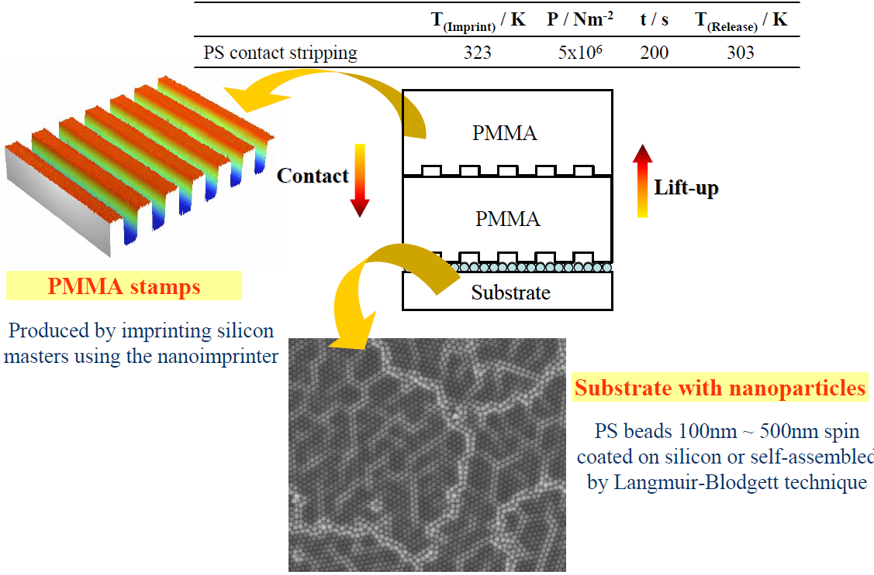
Selective removal by micro-contact stripping (MCS)
Yao et al. Adv. Mater., 2004, 16(1)

Slide 34
Selective removal by micro-contact stripping (MCS)
2μm lines
PDMS mold (very soft), bead “contamination”
between the patterns (room temperature)
PMMA mold
50bar 50ºC
Advantage of PMMA:
Larger areas more homogeneous stripping

Slide 35
Guided by electrostatic and magnetic field
Electrostatic field can be created either by surface charge (e.g. OH⁻ group) or by patterned electrodes on substrates.
Magnetic field can be created by patterning permanent magnetic materials on surface (if putting the whole sample in an external magnetic field, may agglomerate rather than assembly).
When assembly inside or from liquid, capillary force is important.
Difficult to assembly into 2D periodic array (1D is fine) due to repulsive forces among particles.
Magnetic particles can be a polymer sphere (>100nm) encapsulating many super-paramagnetic (<10nm) particles, in order to avoid agglomeratization when no external field.
Capillary force can push charged particles together.
Magnetically assisted self-assembly of magnetic particles

Slide 36
Field induced self assembly
Magnetic field, large objects
Triangles, made of polydimethylsiloxane with magnetized strontium ferrite along the edges, self assemble on the surface of water. The different color triangles are oppositely magnetized so they are expected to have the strongest attractions.
http://mrsec.wisc.edu/Edetc/cineplex/self/index.html
Schematic illustration of nanoscale electro-phoretic deposition of negatively charged nanoparticles onto the PMMA patterned anode substrate.
Zoom in
“Large scale directed assembly of nanoparticles using nanotrench templates”, Appl. Phys. Lett., 2006
50nm polystyrene particles in 50nm trenches

Slide 37
1D self assembly
A–C) Colloidal assembly in external AC electric fields.
Permanent chains from live yeast cells and lectin-functionalized micro-particles.
Self-repairing micro-wires from gold nanoparticles.
Zigzag chains from anisotropic microspheres in AC electrical field.
Zigzag chains formed via templated assembly.
“Materials Fabricated by Micro- and Nanoparticle
Assembly – The Challenging Path from Science to
Engineering”, Advanced Materials, 2009

Slide 38
DNA templated self assembly
DNA is negatively charged in solution, onto which positive metal ions can be reduced to form metal structures.
AFM image of a DNA molecule stretched on a surface and metallized with a layer of palladium.
The particles can be released by heating to “detach” the two DNAs from each other.
C.A. Mirkin et al., Nature 382, (1996) 607

Slide 39
DNA templated Au self assembly
On 270nm dots on 100nm dots
Complexes of neutravidin and single-stranded biotinylated DNA were added to the biotinylated spots via biotin/avidin linkage.
50nm gold colloids tagged with the complementary DNA via thiol bond specifically hybridizes to the surface.
“Nanopatterning of gold colloids for label-free biosensing”, Nanotechnology, 2007

Slide 40
DNA templated self assembly
Holliday junctions occur naturally during homologous recombination where the branch point can shift freely, or
they can be engineered using oligo-nucleotides to create a stable branch point. Note the energetically unfavorable pairing that occurs when the branch point shifts.
Two-dimensional array of three-arm DNA stars forming hexagonal patterns. Insets show the Fourier transform of each image.

Slide 41
Lithography using self assembly: block co-polymer self assembly, porous anodized aluminum oxide and nano-sphere lithography
Di-block copolymer self assembly overview.
Guided (directed, aligned) self assembly.
Block copolymer lithography.
Anodized aluminum oxide (AAO) overview.
Nanofabricating using AAO template.
Nanoparticle self assembly (nanosphere lithography) overview.
Nanofabrication using nanosphere lithography.
Guided nanoparticle self assembly.
Applications of nanosphere lithography

Slide 42
Catalyst (Fe, Co, Ni) patterning for carbon nanotube growth
Nanosphere lithography is the easiest way to pattern metal nano-structure array over large surface area.
(imprint may also be easy, but need to fabricate a mold first; interference lithography needs expensive optical setup)

Slide 43
Plasmon: “bulk”, surface, localized
Plasmon: collective oscillation of free electrons
(has nothing to do with plasma TV (ionized gas))
Surface plasmon:
Plasmon confined to (metal) surface, propagating
-σ₀
+σ₀
t=0
E_{ext}
t=T/2=π/ω (half period)
E_{ext}
Localized surface plasmon: plasmon confined to (metal) nano-structures, non-propagating
Metal nano-sphere
∼frequency of
visible light
Bulk plasmon has no “use”, as hard to excite it – light cannot get into metal, always “screened” at surface
Annu. Rev. Phys. Chem 2007

Slide 44
Lycurgus Cup of the 4th Century
Green = Reflected Light
Red = Transmitted Light
Image of Ag/Au
nanoparticle in the
Lycurgus cup
Color is due to resonant absorption of light, which excites localized surface plasmon when ω(light) ≈ ω(plasmon)
The British Museum. http://www.thebritishmuseum.ac.uk/ (March 2004)

Slide 45
SERS (surface enhanced Raman spectroscopy) fundamentals
incident light
Molecular vibration:
Molecular vibrational energy quantized (phonon).
Its frequency lies in infrared (IR) spectral range.
IR spectroscopy is used to identity a material. (strong absorption when ν(photon)=ν(phonon))
atom
scattered light
Raman scattering:
Inelastic light scattering from a sample with a shift in frequency by the energy of its characteristic molecular vibrations (phonon).
It detects symmetric vibration, which complements IR spectroscopy.
The vibration information is transferred from IR to visible, where brighter sources and more efficient detectors are available.
SERS effect: enormous enhancement (up to 10¹⁴) of Raman scattering when a molecule is adsorbed on nanostructured metallic surface.
This arises from two main mechanisms:
Electromagnetic effect (dominant): localized surface plasmon resonance. (Raman intensity ∝ E⁴ )
Chemical effect: electronic coupling between molecule and metal.
Metal nanostructure
E is very high at corners or edges, and/or when the particle is very small (20-100nm).
E>>E_{ext}

Slide 46
Factors for high SERS enhancement
SERS has extremely high sensitivity, demonstrated single molecule detection.
Higher sensitivity if the nanostructures have sharp edges, and/or tiny (<5nm) gaps between two structures (extremely high field in the gap region). In addition, resonant frequency should be tuned to match laser excitation frequency (typical λ=550-800nm).
Nano-prism by nanosphere lithography offers sharp corner and small (still too big) gap, with tunable resonance wavelength.
Horizontal polarization
Vertical polarization
High field spots
Effect of size and shape on LSPR extinction spectrum for silver nano-prisms and nano-discs formed by nanosphere lithography. (LSPR: localized surface plasmon resonance)
Nano-discs can be fabricated by double layer spheres, or prism followed by electro-chemcial etching to remove sharp corners.
Van Duyne, “Biosensing with plasmonic nanosensors”, Nature Materials, 2008

Slide 47
Colloid nano-crystal
Mono-disperse silica spheres (<5% variation in diameter), diameter range 1 - 2.0 microns, self assembled into fcc lattice
For photonic crystal application, add:
Si infiltration via CVD method, with controled degree of infiltration (0-100%).
Etching of silica sphere by HF, leaving behind interconnected network of air spheres surrounded by Si shells.
Si (n=3.5) is better than SiO₂ (n=1.5) because it has higher refractive index, important for photonic crystal.
Yurii A. Vlasov, Xiang-Zheng Bo, James C. Sturm & David J. Norris, Nature 414,289 (2001)

Slide 48
Self-assembled photonic structures
When electrons move in periodic lattice (crystal), bandgap is formed.
When photon travels in periodic structure (photonic crystal), bandgap can also form.
Just like electron, light cannot propagate when its energy is within the bandgap.
1D photonic crystal is nothing but a Brag reflector (used for EUV mirror).
Observe two peaks at 2.5 microns and 1.46 microns
Two peaks identified are a first stop gap and a full photonic band gap (two hatched areas)
http://en.wikipedia.org/wiki/Photonic_crystal
Blanco A.. John S.. Ozin GA.., “Large-scale synthesis of a silicon photonic crystal with a complete three-dimensional bandgap near 1.5 micrometres” Nature, 405, 437-439 (2000)

Slide 49
Colloidal crystals with tunable colors for photonic papers
Printing colorful patterns without using conventional pigments.
Here the sphere array is like a grating filter, whose transmission or reflection spectrum (color) depends on its period
(and on refractive indexes of the sphere and matrix, and viewing angle; for normal viewing angle, should be something like period=mλ/n, with m being integer and n refractive index).
Basically the “paper” is a colloidal crystal of polymer beads embedded in PDMS elastomerer matrix, whereas the “ink” is a liquid capable of swelling PDMS. (PDMS can be swelled easily by many solvents, which property is usually very undesirable for nanofabrication)
As the elastomer is swollen by ink molecules, lattice constants are changed, so is the color.

Slide 50
Colloidal crystals with tunable colors and their use as photonic papers
If the colors of these states are sufficiently different to be distinguished by the naked eye, the contrast can be exploited to write and display color letters and patterns with certain spatial resolutions.
As the ink molecules are evaporating, the PDMS matrix will gradually shrink back to its originated state and the color patterns will be automatically erased.

Slide 51
Intermolecular forces important for self assembly

Slide 52
Intermolecular forces important for self assembly

